Slide 1
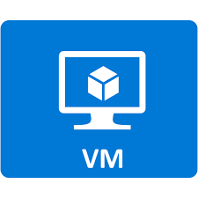
Azure Virtual Machines

Slide 2
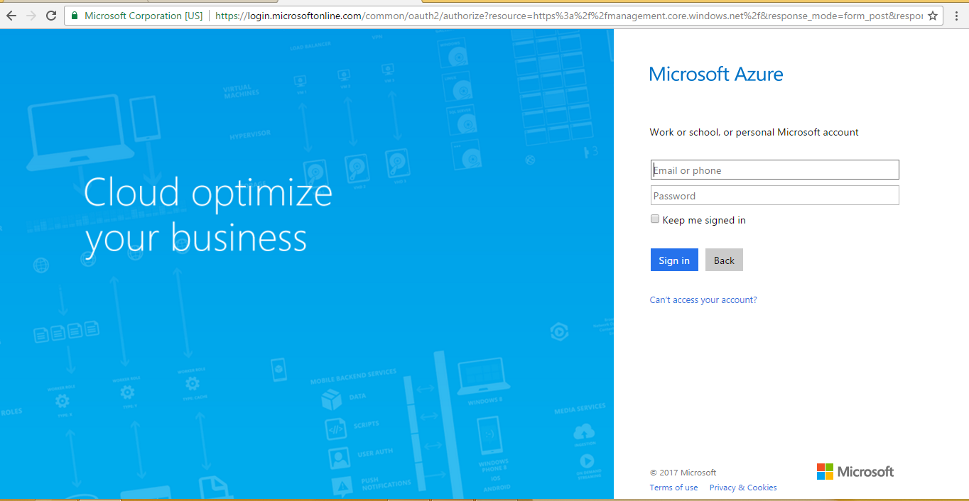
Step 1 : Browse to Azure Portal Via portal.azure.com

Slide 3
Step 2 : Login to Azure Portal

Slide 4
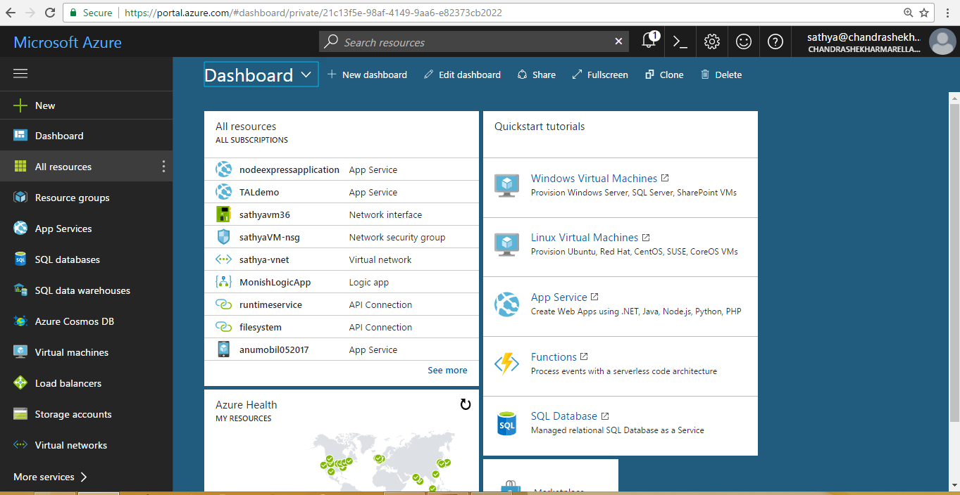
Step 3 :Azure Home page

Slide 5
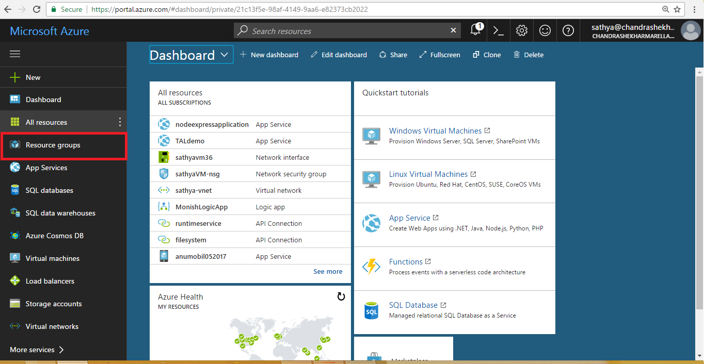
Step 4 : Create Resource Group

Slide 6
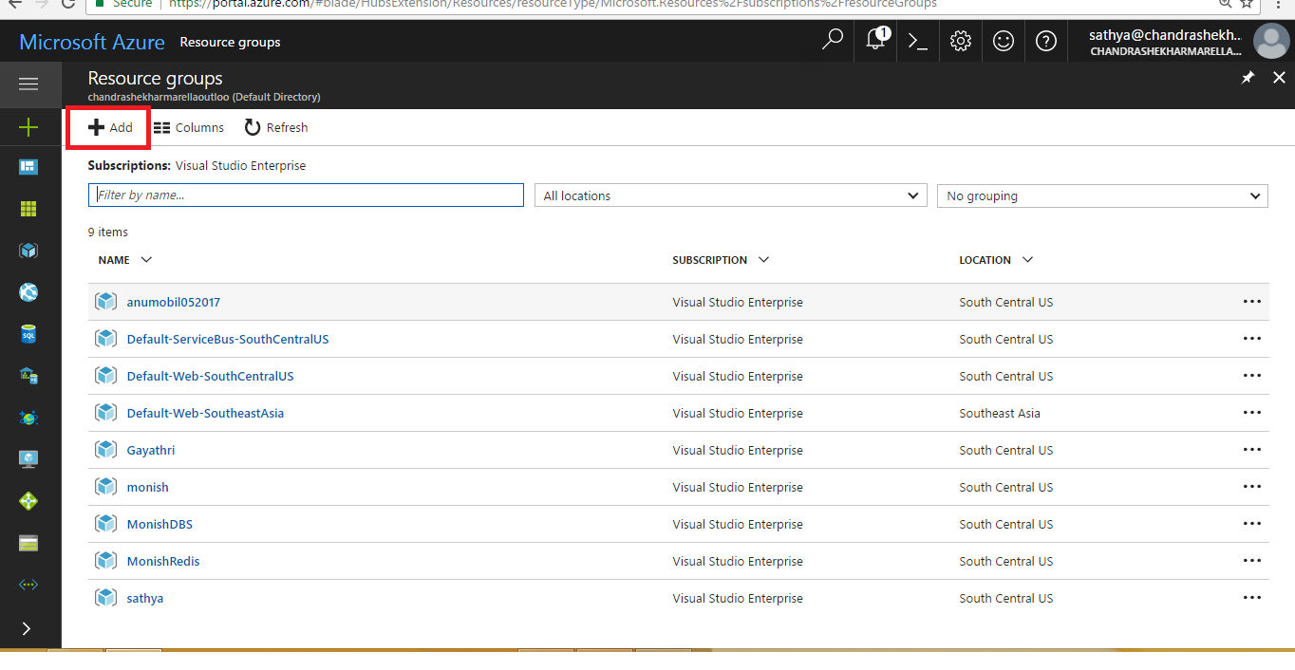
Step 5 : Click ‘Add’ in resource group blade

Slide 7
Step 6 : Configure Resource group

Slide 8
Step 7 : Resource Group Created & To create resources click on the resource group

Slide 9
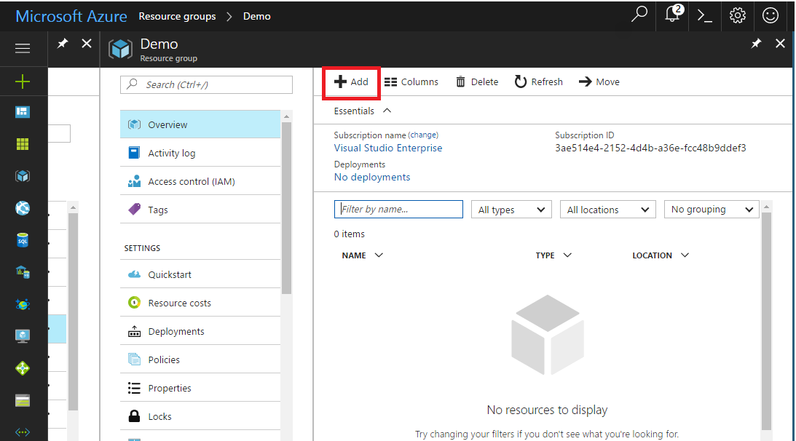
Step 8 : Click ‘Add’ in the Resource group blade

Slide 10
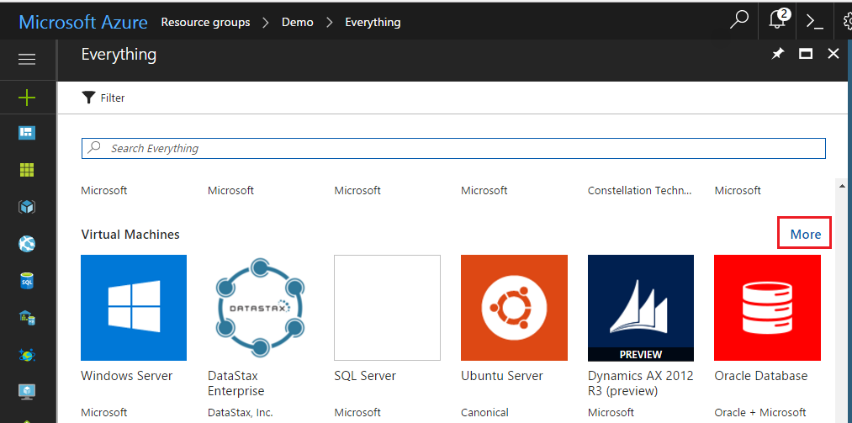
Step 9 : Click ‘More’ in virtual Machines

Slide 11
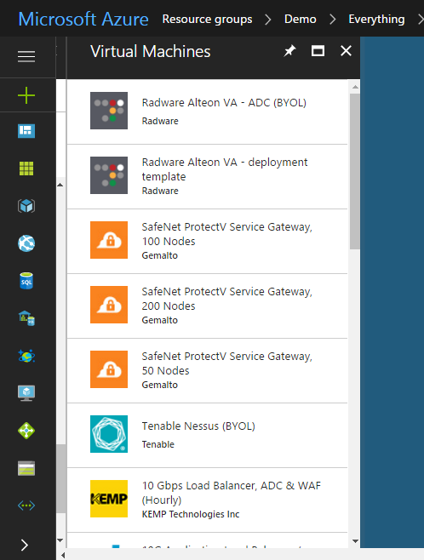
Step 10 : Select from the list of VM available

Slide 12
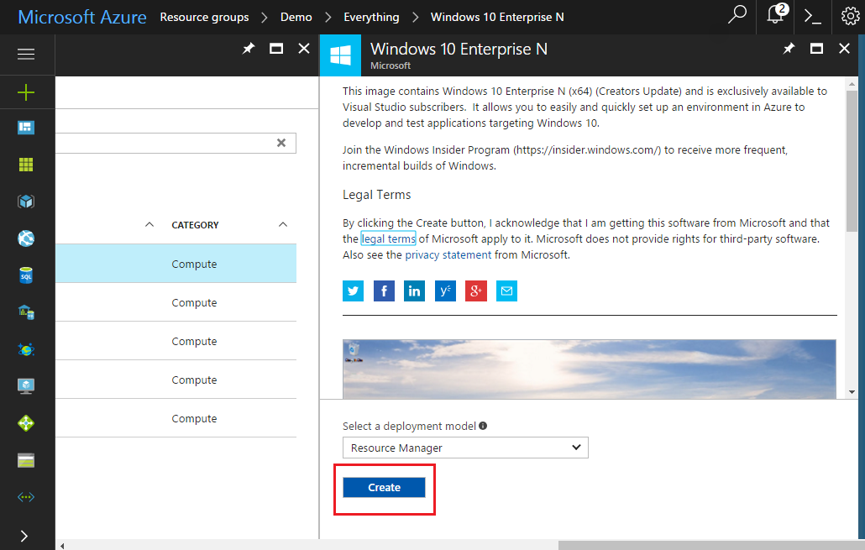
Step 11 : Click ‘Create’ in the VM Blade

Slide 13
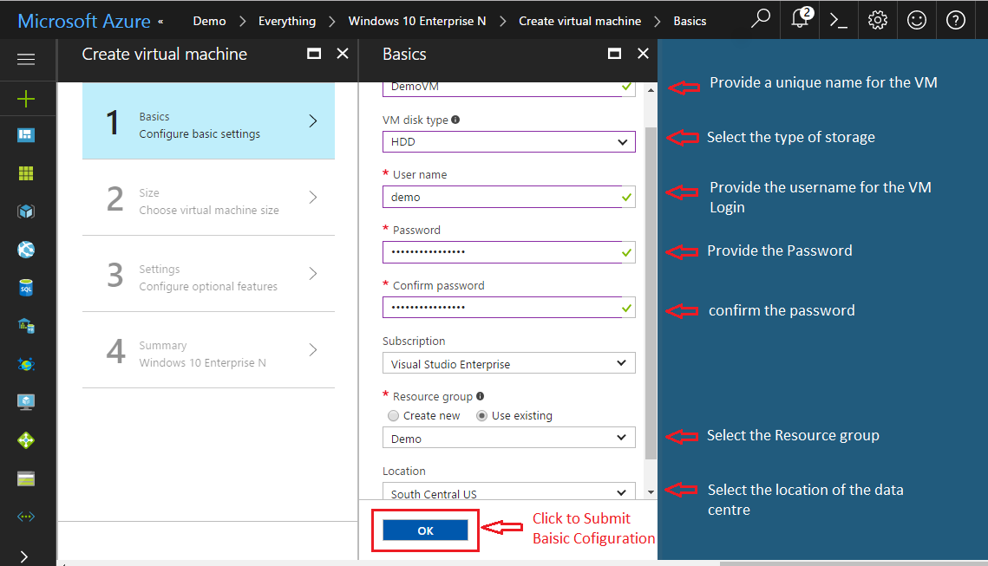
Step 12 : VM Basic configuration

Slide 14
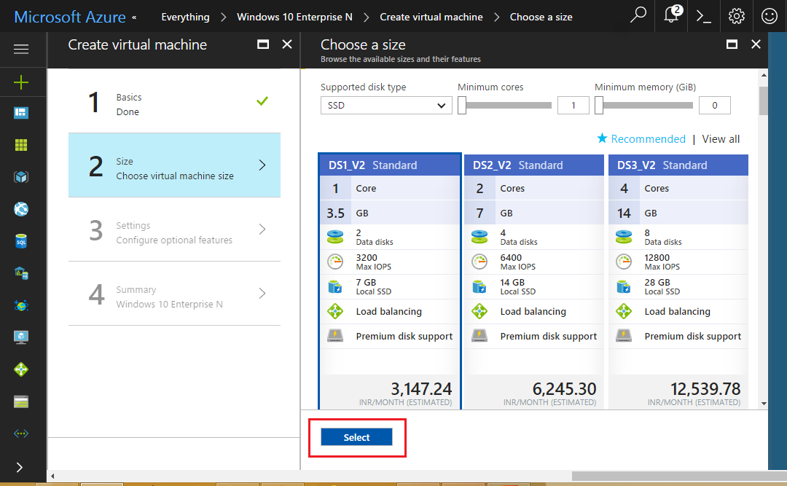
Step 13 : Select Size of the VM

Slide 15
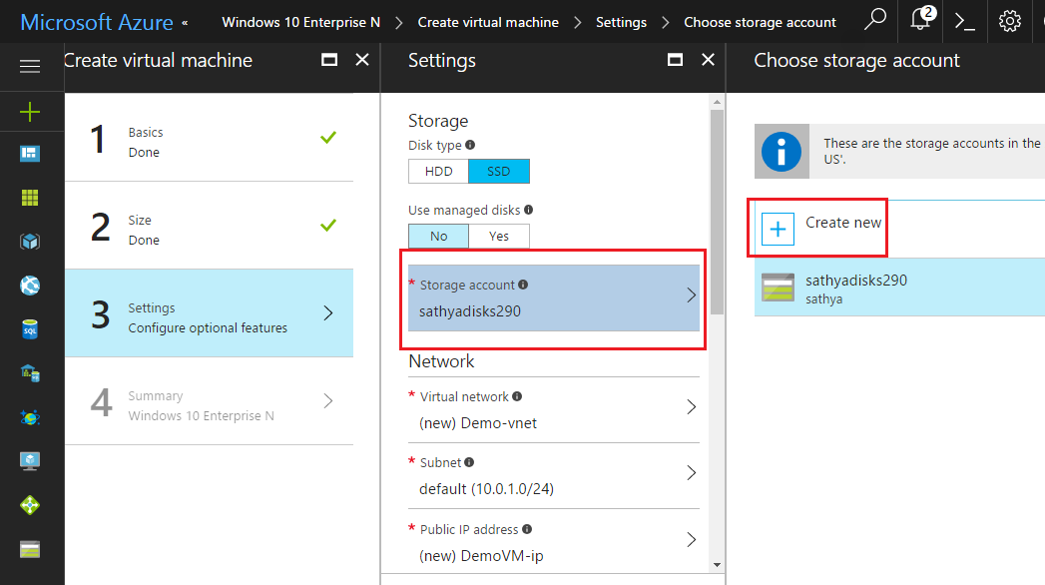
Step 14 : Click ‘Create new’ to add storage account for VM

Slide 16
Step 15 : Configure Storage account for the VM

Slide 17
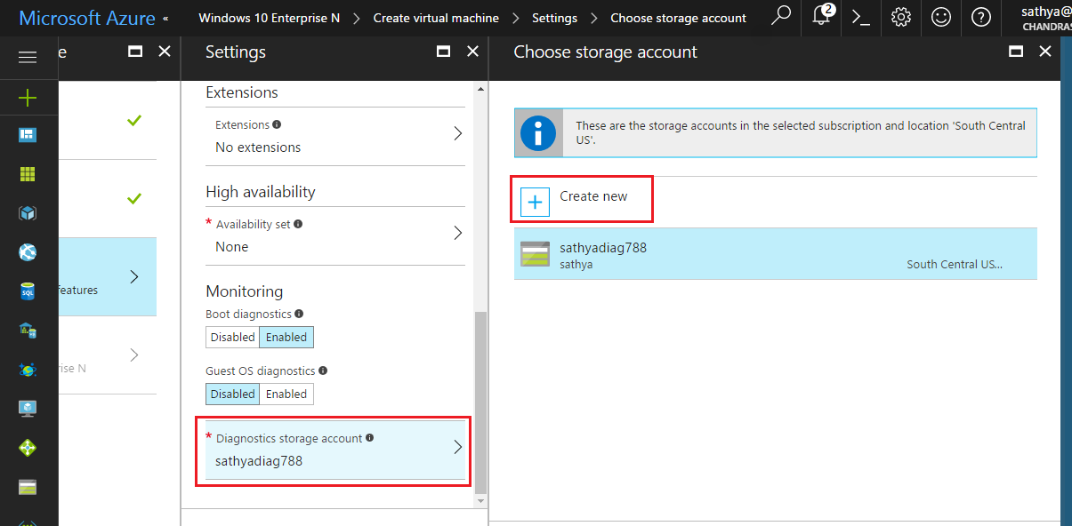
Step 16 : Click ‘Create new’ to add diagnostic storage account for VM

Slide 18
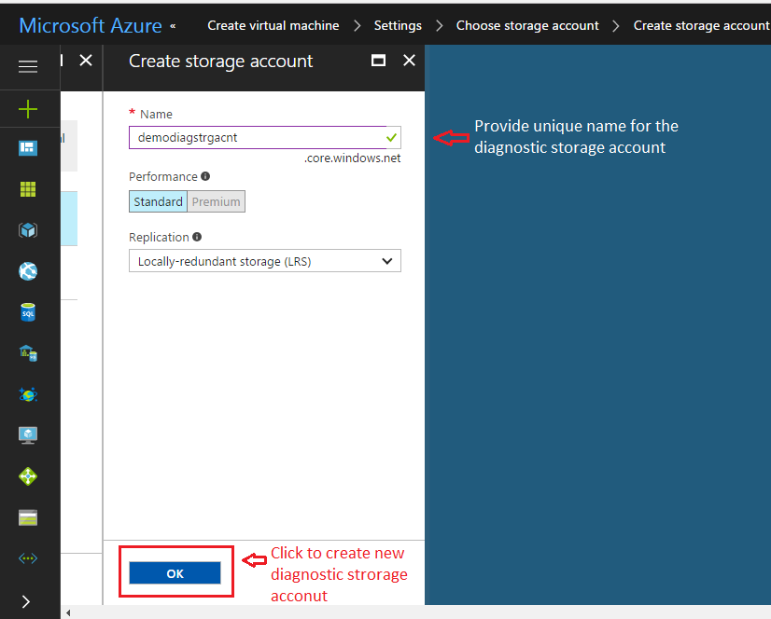
Step 17 : Configure Diagnostic Storage account for the VM

Slide 19
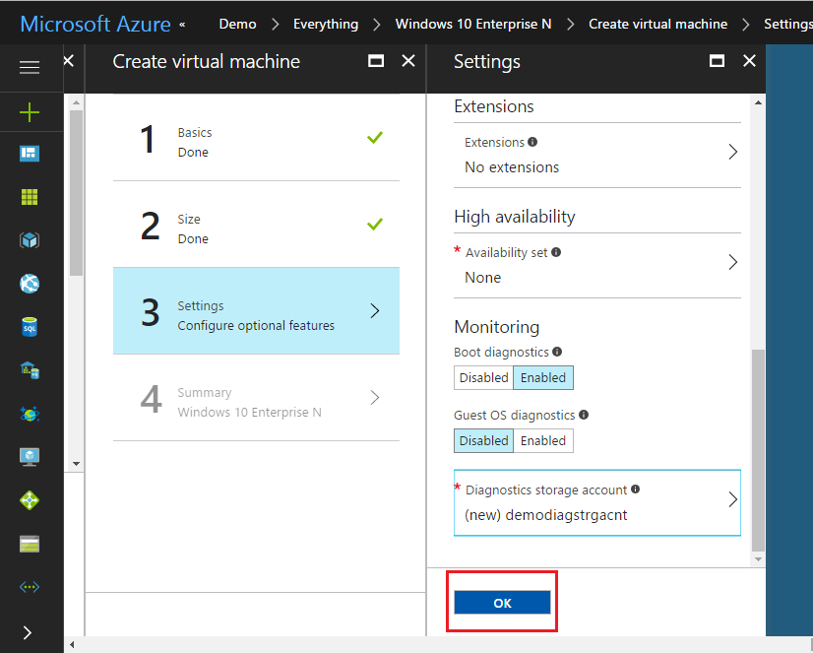
Step 18 : Click ‘Ok’ to submit the Storage Configurations

Slide 20
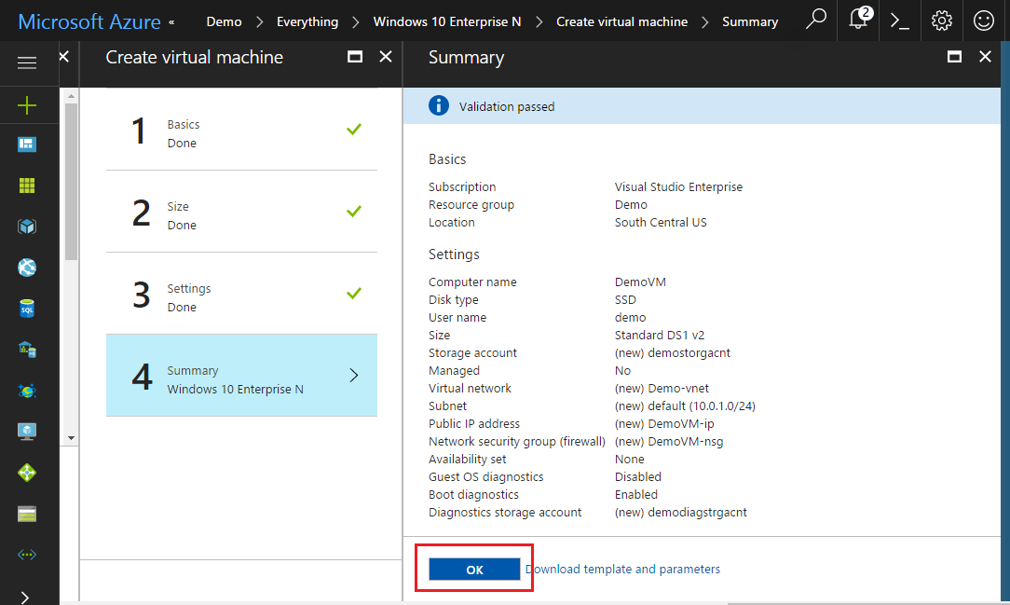
Step 19 : Review the Summary & Submit

Slide 21
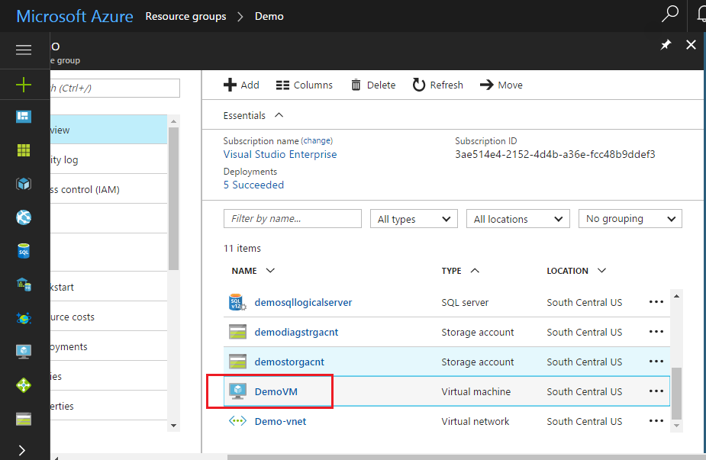
Step 20 : VM is Created & Click on the VM in resource group

Slide 22
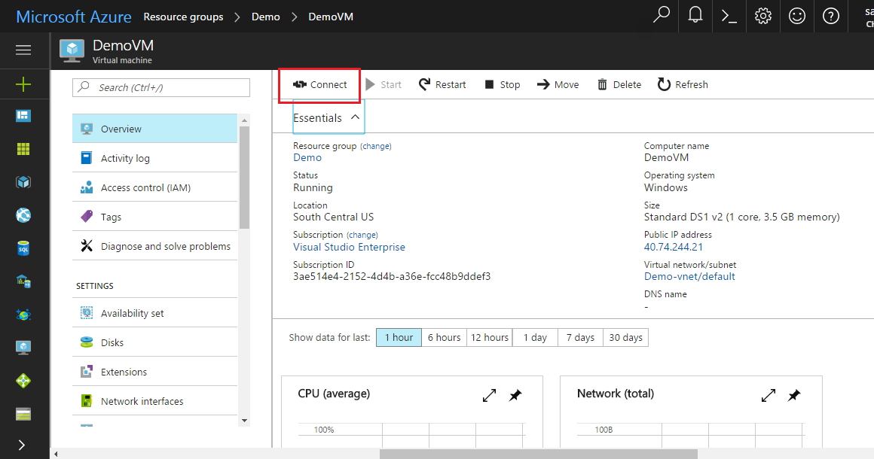
Step 21 : Click connect to download .rdp file

Slide 23
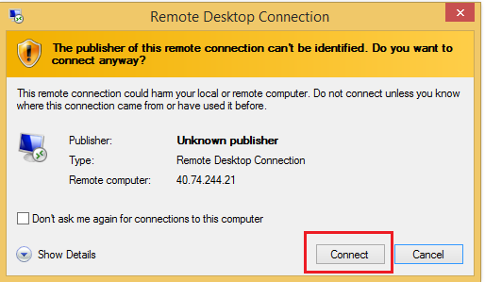
Step 22 : Open the .rdp file & Click on ‘Connect’

Slide 24
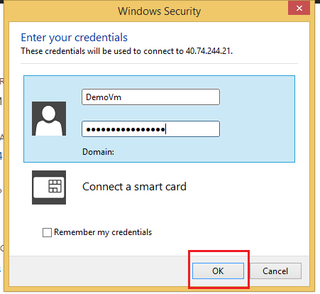
Step 23 : Provide VM Credentials & Click ‘Ok’

Slide 25
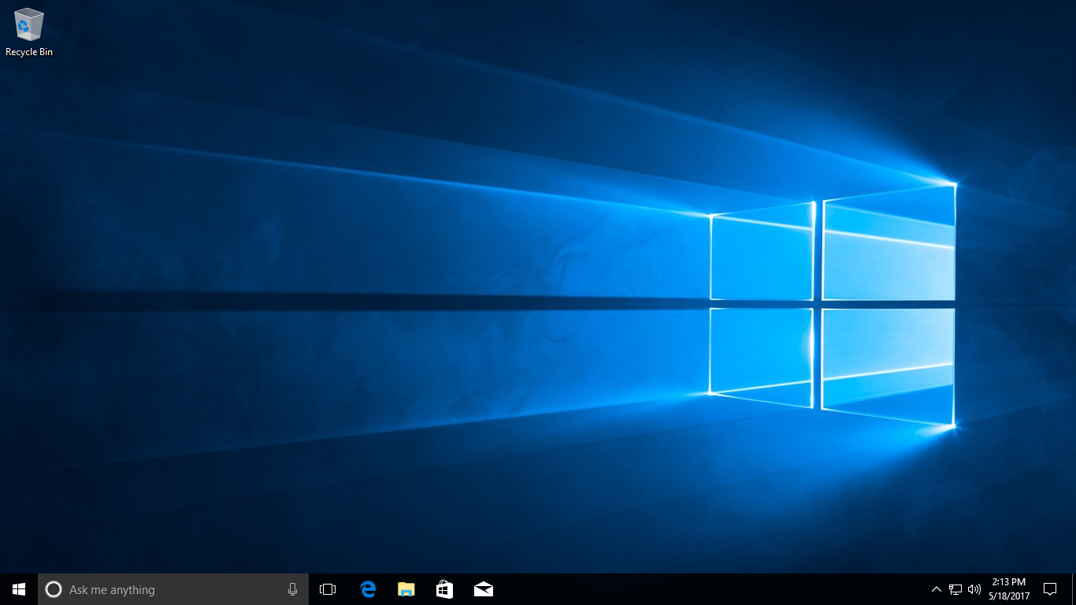
Step 24 : VM Connected

Slide 26
Thank You
Visit us at www.techmahindra.com

